Slide 1


Flue gas flow rate measurement for verifying continuous monitoring at power stations according to
EN ISO 16911
  16 September 2016
Confidential
Restricted
Public
Internal

Slide 2

Context, challenges, objectives, work program

Slide 3
Context
Flue gas flow monitoring
  linked to European Directives, including the Industrial Emissions Directive (IED), mass emissions reporting for E-PRTR and the EU Emissions Trading System (EU ETS) for CO2 and for emissions of N2O and CH4 from other sectors
  subject to defined uncertainty requirements
New standard EN ISO 16911:2013 (part 1 and 2)
  WG required flow monitors (AMS) for large combustion plants
  Flow calculation still accepted if calibrated with yearly manual measurements
Project: to calibrate flow monitors or calculate with
  Point velocity measurement (20 point survey on 2 diameters):
    Pitot tubes (DP) (L, S, 2D, 3D)
    Vane anemometer (direct V)
  Tracer dilution technique
  Tracer transit time technique
Notes:
E-PRTR: The European Pollutant Release and Transfer Register (E-PRTR)

Slide 4
QAL2 Calibration – Departures from EN 14181
QAL2 test duration – at least one day (cf 3 days) if preliminary study is OK (CFD,…)
‘Daily Emission Limit Value’ = 1.2 * Max measured flow
Method D introduced (calibration line forced through zero)
R2 > 0.9 (cf no requirement) ; σ_{o} = 4% (cf σ₀ = 10% of ELV for NOx)
Competent Authority may require another value for σ₀
Note - some instruments susceptible to flow disturbance

Slide 5
Project objectives
  Define best practices
Define a common approach to verify calculations
Provide guidance on the choice of stack testing methods for use at coal and gas fired plant
Method testing on wet stacks
Method testing on flows with swirl (no appropriate location found)
Provide tools to cross-compare calculated and measured flue gas flow rate and to apply the statistical tests required by the standard

Slide 6
Work program
Calibration of instruments
  S-pitot, L-pitot, 3D pitot, Vane anemometers
Measurements at a gas fired power station (Field trial 1: CCGT)
  S-Pitot, L-pitots, 3D pitot, vane anemometers, tracer gas injection
Measurements at a coal fired power station (Field trial 2: wet stack)
  S-Pitot, L-pitots, 3D pitot, vane anemometers, tracer gas injection
Analysis
  Result analysis
  Development of the calculation tools
  Conclusion drafting
  Recommendation drafting for gas/coal fired and wet/dry gases

Slide 7




Project partners

Slide 8
Calibration of instruments
chapter title

Slide 9
Calibration
  Objectives
Comparison between calibration in France and in UK
  To have the instruments calibrated for the project
  To assess the compliance of the laboratory testing/calibration procedure with the new standard ISO/FDIS 16911-1:2012 requirements
  To compare the calibration results obtained by the two laboratories
To compare the calibrations, E-ON and LABORELEC thought that it was better to dissociate the uncertainty from the instrument and the uncertainty from the pressure sensor
(pressure sensors of the laboratory were used)

Slide 10
Calibration
  Performance characteristics and requirements for laboratory testing
Parameter | Criterion | Method of determination
Standard deviation of repeatability of measurement in the laboratory | < 1 % of value | Performance evaluation in wind tunnel at values spanning
Lack- of-fit (Linearity) | < 2 % of value | Maximum deviation from linear fit at five velocity levels in wind tunnel
Uncertainty due to calibration | < 2 % of full scale | From calibration certificate for measurement equipment
Lowest measureable flow (limit of quantification) | No criterion, but should be determined. | This parameter shall be determined, but is not a performance requirement. The sensor shall not be used to measure flows below its limit of quantification
Sensitivity to ambient temperature Note: Only external components are affected by ambient conditions. | ≤ 2 % of range per 10 K | Performance evaluation of measurement device.
Sensitivity to atmospheric pressure | pressure ≤ 2% of range per 2 KPa | Performance evaluation of the measurement device
Effect of angle of sensor to flow | ≤ 3% at 15 degrees (on the velocity?) | Performance Evaluation of measurement device

Slide 11
Calibration
  L-pitot
Stable pitot-constants at different velocities
France vs UK k-average: 0.3% difference in velocity

Slide 12
Calibration
  L-pitot
Stable pitot-constants at different velocities
France vs UK k-average: 0.3% difference in velocity

Slide 13
Calibration
  S-pitot
Scattered pitot-constants at different velocities
France: highest k vs lowest k → 2.6% difference on the velocity
UK: highest k vs lowest k → 1.8% difference on the velocity (less spread)
France vs UK k-average: 0.7% difference in velocity

Slide 14
Calibration
  S-pitot
Scattered pitot-constants at different velocities
France: highest k vs lowest k → 2.6% difference on the velocity
UK: highest k vs lowest k → 1.8% difference on the velocity (less spread)
France vs UK k-average: 0.7% difference in velocity

Slide 15
Calibration
  Vane anemometer
during the UK calibrations, the biggest relative difference, (Vi-Vr)/Vr observed between the instrument reading and the reference velocity was at 2.552 m/s with a deviation of
-0.062 m/s which is 2.4% of the value and 0.16% of the maximum velocity of 37.47 m/s

Slide 16
Calibration
  Vane anemometer

Slide 17
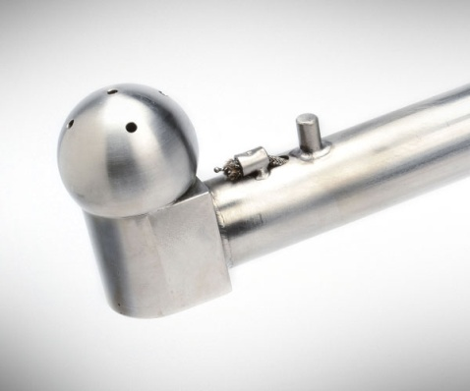
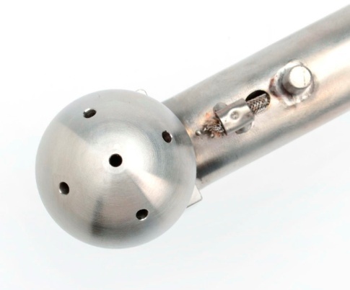
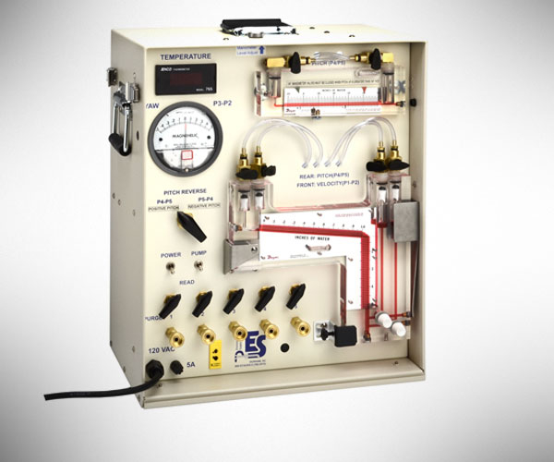
Calibration
  3D-pitot
Called “clinometers” by the laboratory
No calibration possible in wind tunnels designed for generating laminar flow
Only the ΔP were checked between P1-P2 and between P4-P5 for each of the five velocities

Slide 18
Calibration
  Effect of the angle tested in France
 | Small velocity |  | High velocity
 | ± 2.5 m/s |  | ± 38 m/s
 | +15° | -15° | +15° | -15°
L-pitot | 0.99 | 0.97 | 0.99 | 0.98
S-pitot (E-ON) | 0.98 | 0.99 | 1.02 | 1.03
S-pitot (LBE) | 1.02 | 1.04 | 1.06 | 1.06
Anemomoter (LBE) | 1.00 | 0.93 | 0.98 | 0.95
Pitots:
  Square root of the pressure (impact on the velocity) @ ± 15°/ square root of the pressure @ 0°
Anemometer:
  Velocity @ ± 15°/ highest velocity @ ± 0°
Standard: impact of turning the instruments of ± 15° has to be < 3 %.

Slide 19
Calibration
  Effect of the angle tested in France: conclusion
 | ± 2.5 m/s |  | ± 38 m/s
 | +15° | -15° | +15° | -15°
L-pitot | 0.99 | 0.97 | 0.99 | 0.98
S-pitot (E-ON) | 0.98 | 0.99 | 1.02 | 1.03
S-pitot (LBE) | 1.02 | 1.04 | 1.06 | 1.06
Anemomoter (LBE) | 1.00 | 0.93 | 0.98 | 0.95
Pitots:
  Both S-pitots were not affected the same way and/or in the same magnitude
  LBE S-pitot more sensitive than E-ON S-pitot
  E-ON S-pitot:
    stays in allowed limits in all cases
  LBE S-pitot:
    Negative angles not OK at low and high velocities (impact > 3% of the velocity)
    positive angles not OK at high velocities
  E-ON S-pitot and the L-pitots are less sensitive to the angles
Anemometer:
  more affected by negative angles

Slide 20
Calibration
  Conclusions
L-pitot
  Less sensitive to velocities or angle variations
  K-factor very stable with changing velocities
S-pitot
  Highest scattering for velocities below 15 m/s
Vane anemometer
  Very close to the reference velocities in Paris and more dispersed in the UK
  Sensitive to angle variations
  Suitable for laminar flows
Expanded uncertainty
  L-pitot < vane anemometer < S-pitot
  For the pitots, other uncertainties should be taken into account to determine the calibration uncertainty.

Slide 21
Field trial 1
CCGT

Slide 22
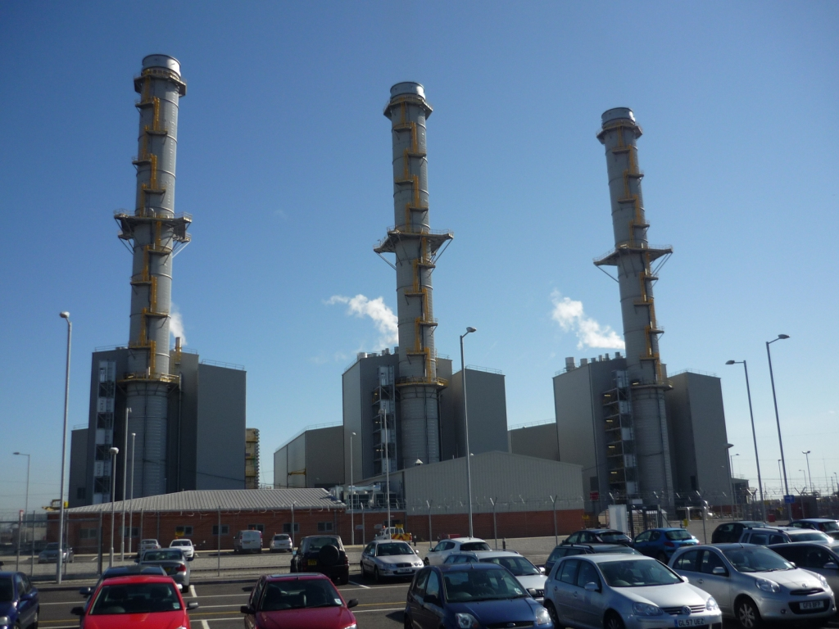
Field trial 1: CCGT
  7m diameter
Test platform

Slide 23
Field trial 1: CCGT
  Results
 | V_{god} | Nm³/s |  | 0 vol % O₂ Dry, STP
 | no. Meas | Slope | Max | |D| | limit |D| | sD | Max sD | R² | Limit R²
Ref. L-Pitot | 14 | 1.034 | 185.5 | 5.67 | 10.42 | 3.201 | 8.679 | 0.986 | 0.90
3D Pitot | 15 | 1.005 | 178.8 | 0.76 | 9.33 | 1.642 | 8.382 | 0.996 | 0.90
S-Pitot | 15 | 1.078 | 197.5 | 12.89 | 11.25 | 3.887 | 9.254 | 0.979 | 0.90
Vane anemometer | 14 | 1.042 | 185.2 | 6.86 | 9.48 | 1.255 | 8.665 | 0.998 | 0.90
Tracer Gas | 20 | 0.998 | 185.4 | 0.27 | 10.40 | 3.880 | 8.742 | 0.986 | 0.90
Ref L-pitot: performs reasonably well, 3.4% higher than the calculation (fixed point)
3D-pitot: performs extremely well, 0.5% higher than the calculation, individual measurements very stable, standard deviation of differences (sD) is very small
S-pitot: measurements are 7.8% higher than the calculation, does not meet the criteria
Vane anemometer: performs well, measurements are 4.2% higher than the calculation, meets the criteria
Tracer gas method: performs very well, measurements are 0.2% lower. A slow drift occurred during the measurements which increased the deviation.

Slide 24
Field trial 2
Coal fired power plant
(wet stack)

Slide 25
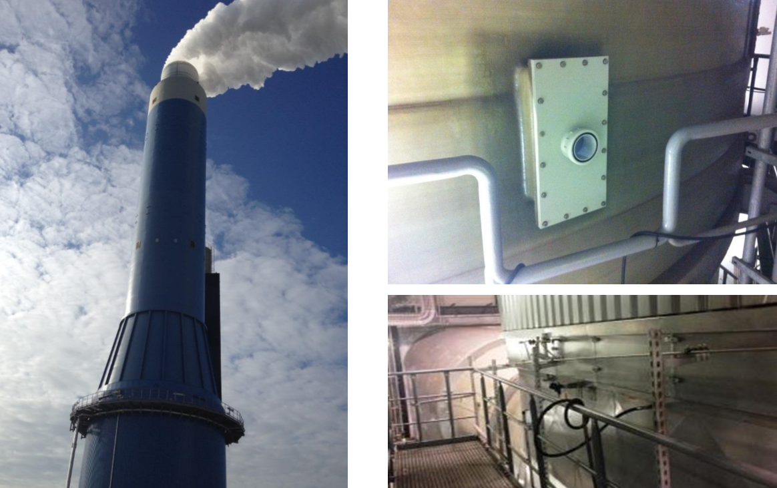
Field trial 2: Wet stack
  8m diameter
Test platform

Slide 26
Field trial 2: Wet stack
  Results
 | V_{god} | Nm³/s |  | 0 vol % O₂ Dry, STP |  | From Plant calc.
 | no. Meas | Slope | Max | |D| | limit |D| | sD | Max sD | R² | Limit R²
Ref. L-Pitot | 10 | 1.040 | 565.8 | 19.14 | 53.14 | 44.820 | 25.501 | 0.832 | 0.90
3D Pitot | 11 | 1.000 | 577.2 | 0.22 | 33.63 | 10.844 | 26.795 | 0.994 | 0.90
S-Pitot | 11 | 1.057 | 604.0 | 27.36 | 33.67 | 8.565 | 28.010 | 0.997 | 0.90
Vane anemometer | 9 | 1.066 | 606.0 | 30.77 | 39.37 | 16.584 | 27.894 | 0.990 | 0.90
Tracer Gas | 19 | 1.021 | 592.5 | 11.74 | 31.56 | 7.837 | 27.917 | SP<15% | 0.90
Ref L-pitot: higher flow variation than for CCGT, frequent blockages (dust + water). Fixed point, not suitable for comparison
3D-pitot: performs very good, meets the criteria
S-pitot: performs good, meets the criteria
Vane anemometer: performs good, meets the criteria
Tracer gas method: performs very well, meets the criteria

Slide 27
General conclusion

Slide 28
General conclusions
How to calculate the uncertainties of the SRM-instruments is unclear
The laboratories performing the calibration of the SRM instruments were not yet used to the EN16911 requirements
The 5 tested measuring methods were in general in line with the stack flow calculation:
  The criterion for the standard deviation of differences is easily met
  The R-squared criterion is even much easier met
  If the test is performed on the actual measured velocity the results are nearly exactly the same
3D-pitot and tracer method provide results the closest to the stack flow calculation
Impact of the swirl was not tested
Wet stack: all the methods could be used but
  measuring openings could block (mostly L-pitot, 3D-pitot)
  Vane anemometer can give wrong results if droplets stick to the vane
Tracer dilution methods are rapid, can measure the dry stack flow rate directly (for comparison with calculated flow) and do not require the stack diameter/cross-sectional area. However, tracer gas cylinders and a suitable tracer injection point are required.

